Slide 1


Features Concepts & Planning
1F10191005_Thant Min Htet
Planning, Idea storming and Research
Features
-Realtime web-based chat
application for university students.
-Casual group communication purpose and discussions.
-Authentication with Google or Facebook account.
Real time data exchange, Chat feed, group discussions, Dark theme, INIAD color theme.
Design Concept
Testing Web Technology to create website
Testing Potential Features and available api
User flow, Site map, Wireframes
Potential Features
-Voice to text converting messages.
-Downloadable Chat messages into pdf, txt, docx files.
Couldn’t be able to added in this version. But will be able to implement and these features can be useful for the online classes in INIAD.
Application Development
(JSX/CSS/JS, React.js)
Real time data handling, API Implementation, Authentication and deployment. (Firebase, ChatEngine.io)
Finished Product and Deployment on Heroku

Slide 2
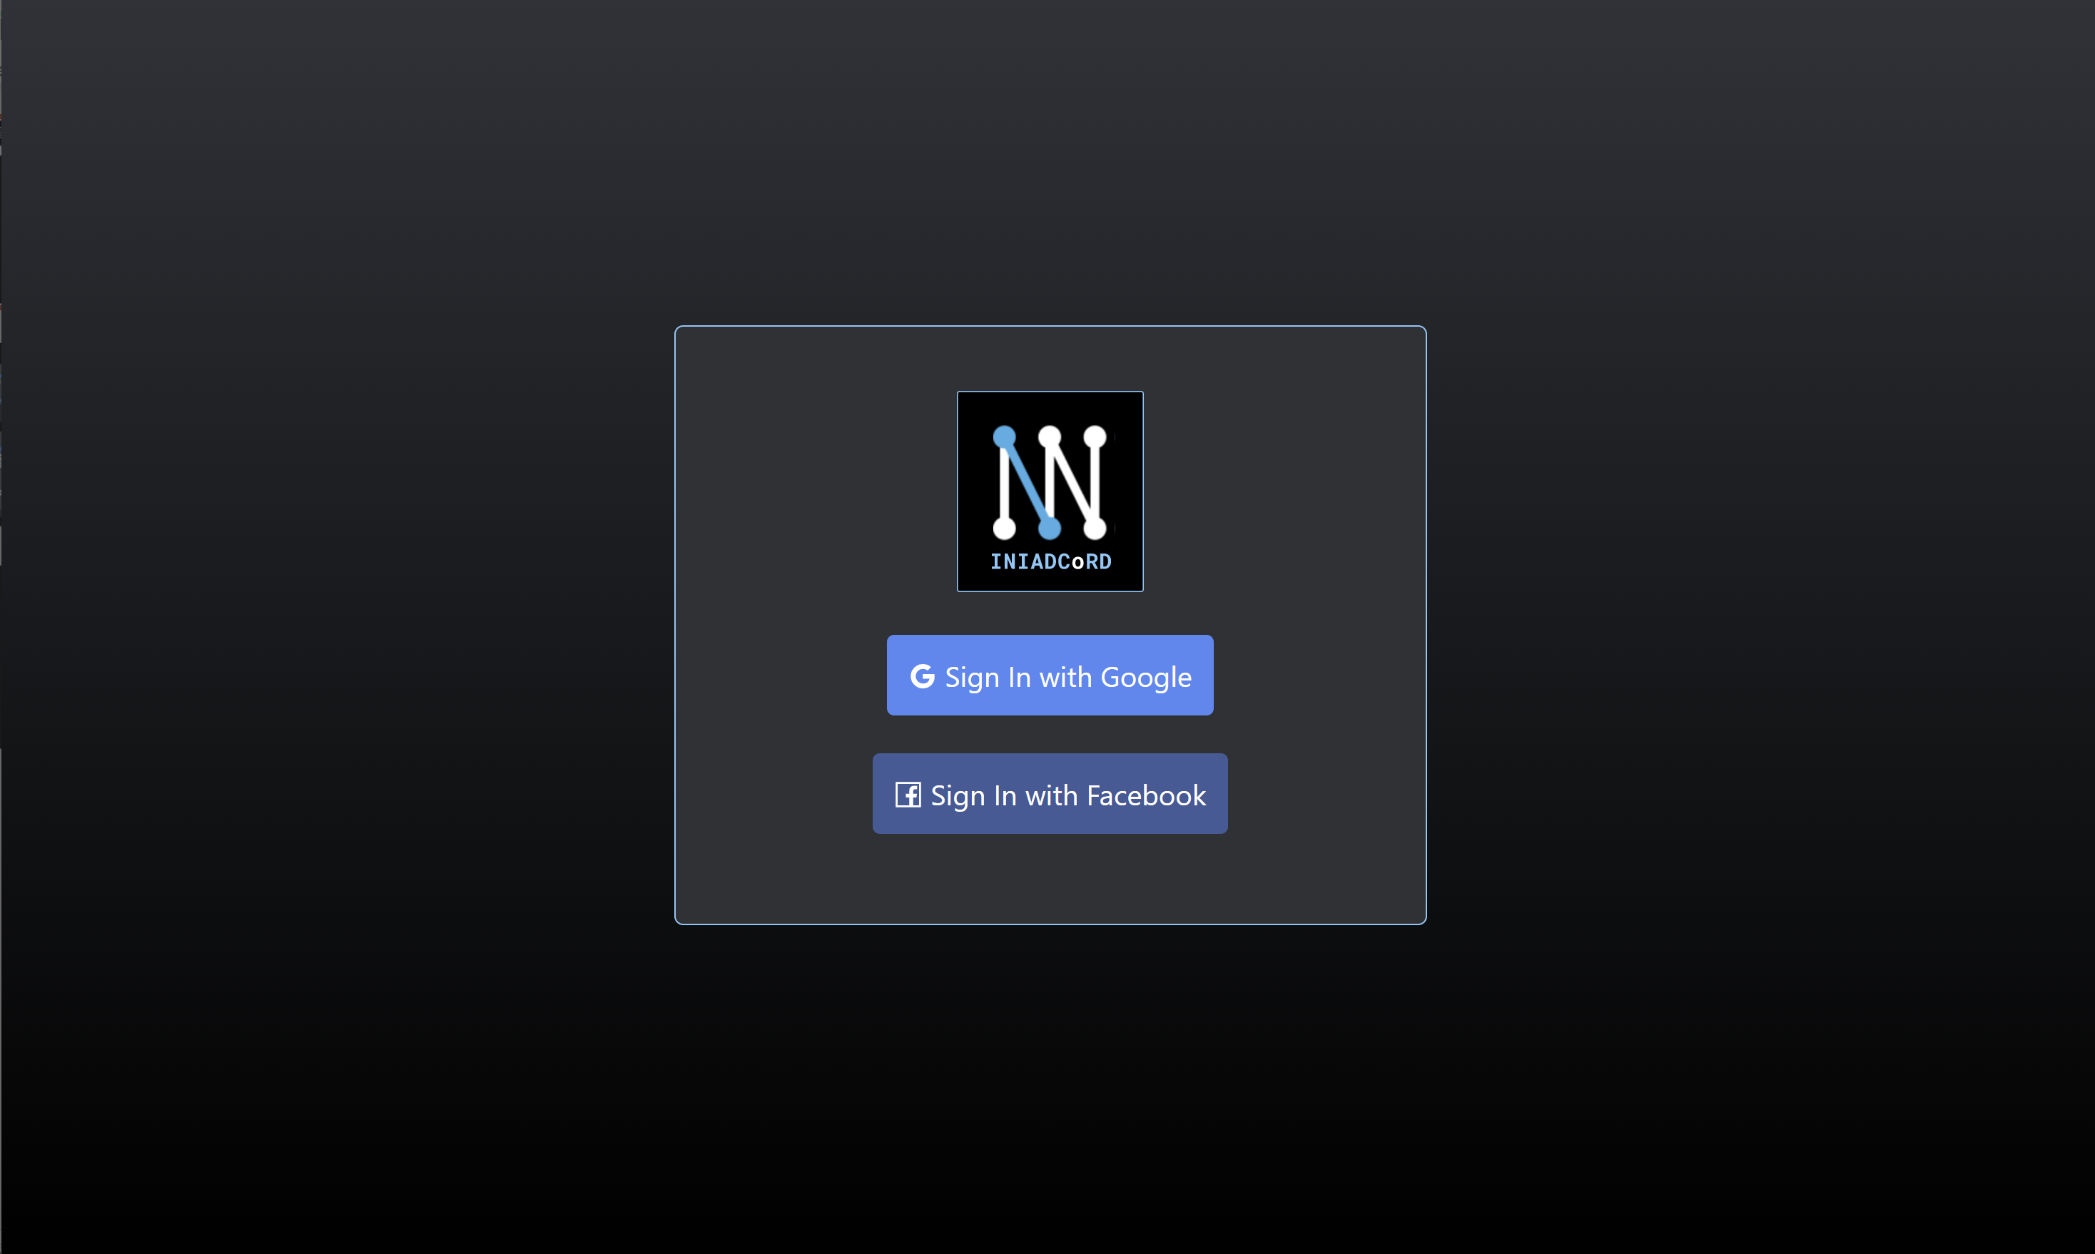


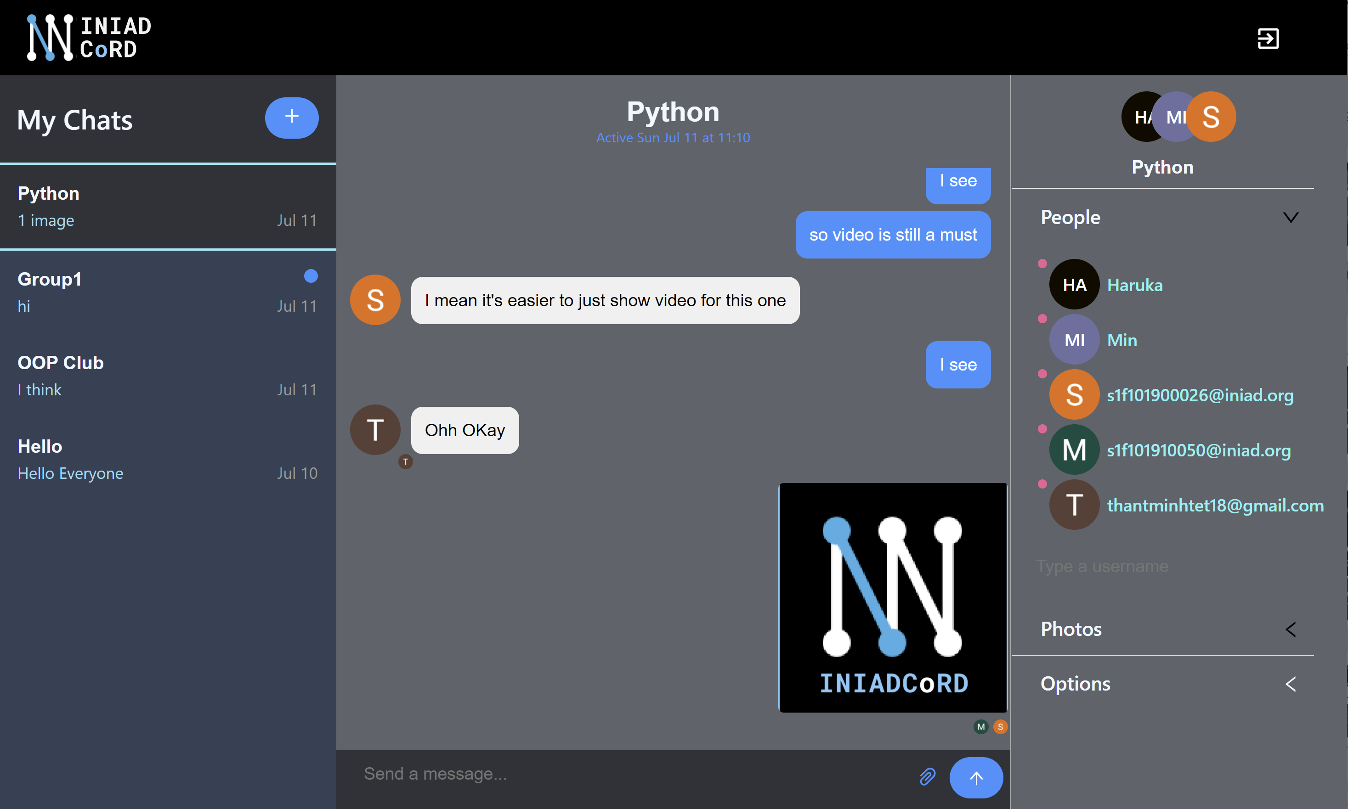

Design & Development
1F10191005_Thant Min Htet
Firebase is utilized for Authentication.
React.js is mainly used for the front-end site and Chatengine.io for chat API.
Authentication
Provide Chat API
Firebase
-This service is used for Authentication with login services.
ChatEngine.io
-This service is used for chat API development and real time data update. UI kit was utilized in this project.
Netlify
-This service is used for hosting the chat application
INAIDCord Application
Deploy
Netlify Cloud Hosting

Slide 3
Deployment & References
1F10191005_Thant Min Htet
The application is deployed on netlify cloud. Please Check the site from this link. https://iniad-cord.netlify.app/chats
References
Chatengine.io: https://chatengine.io/docs/getting_started
Firebase: https://firebase.google.com/docs
Material-ui: https://material-ui.com/store/?utm_source=docs&utm_medium=referral&utm_campaign=home-store
React: https://reactjs.org/docs/getting-started.html
Others: https://www.buymeacoffee.com/JSMastery
Note: Real time data exchange, and Chat API and authentication features were developed using of Firebase and Chatengine.io. The UI and designs were customized based on the design features and wireframes that I developed. The logo from material.io were used here. The UI kit was based on the Chatengine.io.
References

